Slide 1

GROUP 13

Slide 2



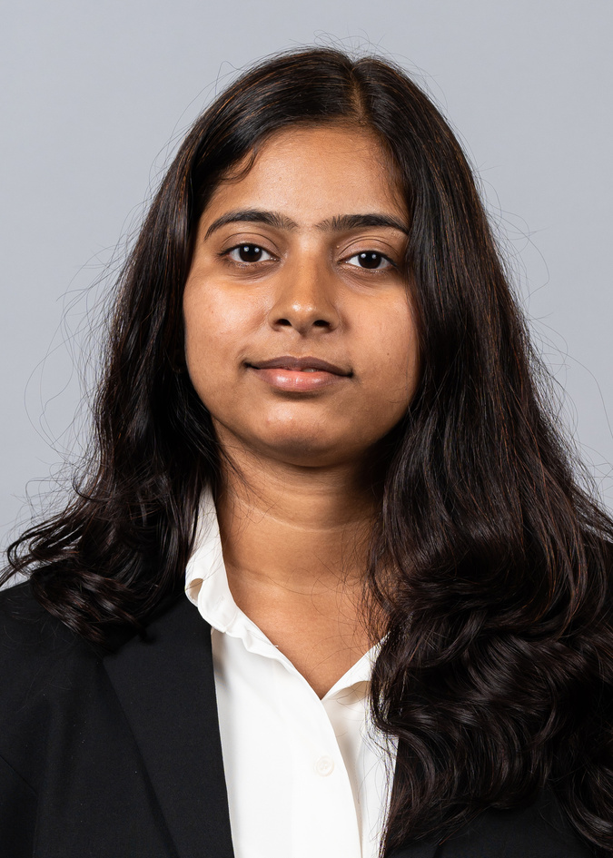
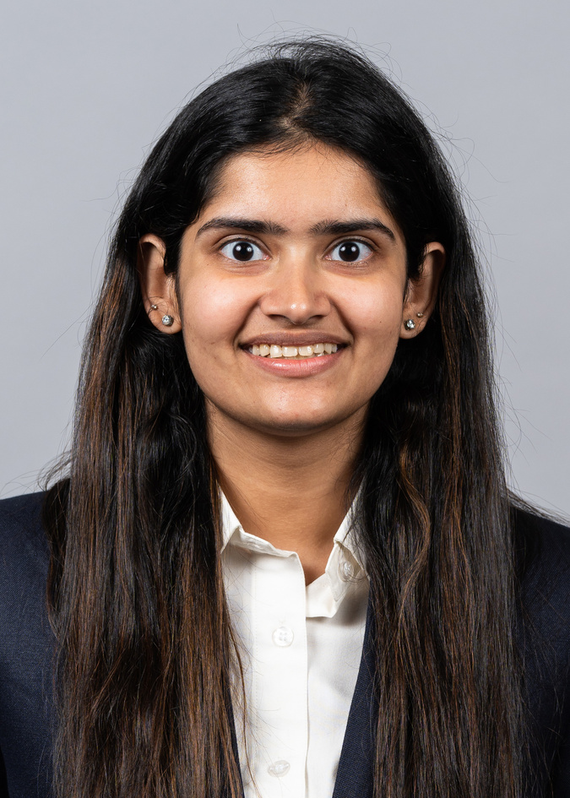
MEET OUR TEAM
AMOGHVARSH
KULKARNI
VEDANT
KAMAT
SAI THANMAYI
KARPURAPU
DEVNI
SHAH

Slide 3
contents
Background
Introduction
01
02
Users
Mission statement and
Mission objectives
Data/Source
Database Design
Use CaseS
03
04
Conceptual, logical and
physical database design
Using SQL and
Tableau results
05
INSIGHTS

Slide 4

01
background

Slide 5

CLIENT
Our client is University of Maryland women’s softball team, who have approached us to provide valuable insights and recommendations to help improvetheir game play for the 2024 season.

Slide 6


data/source
SOURCE: https://umterps.com/sports/softball/schedule
TIME PERIOD:
2000-2023
DATA INCLUDES:
The date and day when University of Maryland's softball team competed against an opponent at a location and match’s result.

Slide 7
USERS
Softball Team (Players, Coaches)
Athletic Directors and Administrators
University Administration
Fans and Alumni

Slide 8
02
introduction

Slide 9
mission statement
As consultants, our mission is to serve as the catalyst for the University of Maryland women softball team's transformation, to equip the team with actionable recommendations, enabling them to elevate performance standards and establish a legacy of sporting achievement.

Slide 10
mission objectiveS
01
Analyse the top 10 teams where Maryland has lost against the maximum number of times
02
Analyse the top 10 away locations where Maryland has won the most number of times
03
Analyse the top 10 matches where Maryland has won with a shutout
Analyse the top 10 of teams against which Maryland has won maximum number of times
04
05
Analyse the top 10 teams against whom Maryland has won by the highest margin

Slide 11
03
database
design

Slide 12
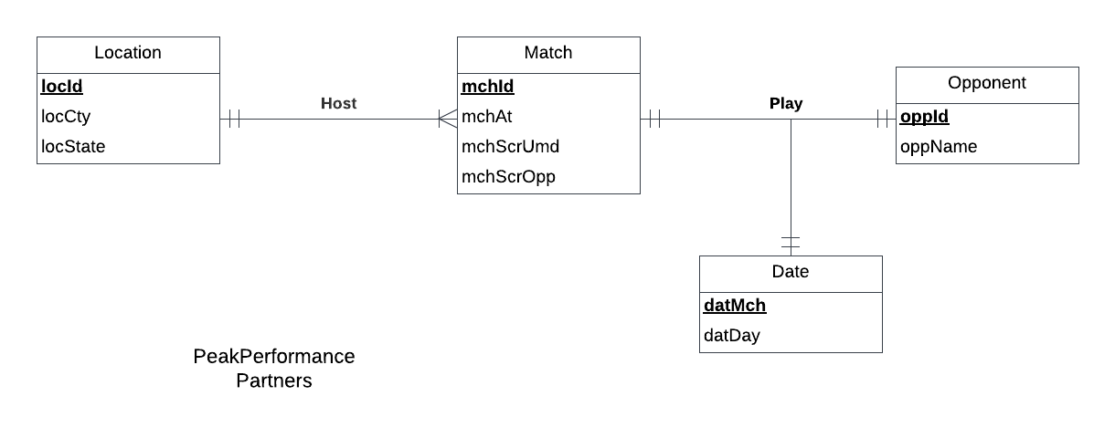
ER DIAGRAM

Slide 13
RELATIONAL SCHEMAS
Match (mchId ,mchAt, mchScrUmd, mchScrOpp,locId)
Date (datMch , datDay)
Location (locId , locCty ,locState)
Opponent (oppId , oppName)
Play (mchId , datMch , oppId)

Slide 14
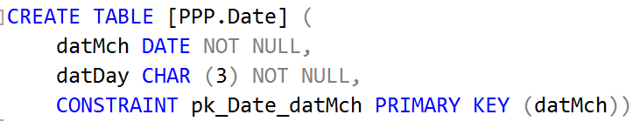
SQL CREATE TABLE: DATE

Slide 15
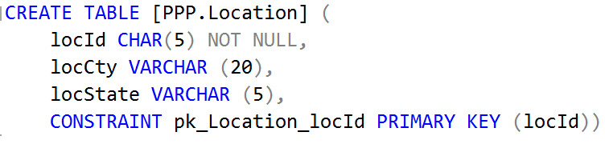
SQL CREATE TABLE: LOCATION

Slide 16
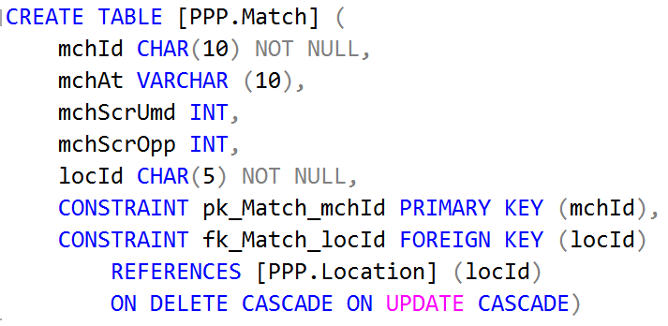
SQL CREATE TABLE: MATCH

Slide 17
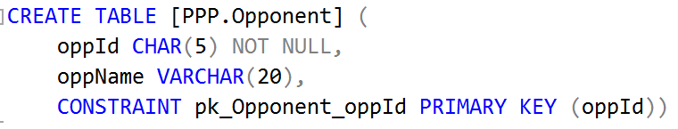
SQL CREATE TABLE: OPPONENT

Slide 18
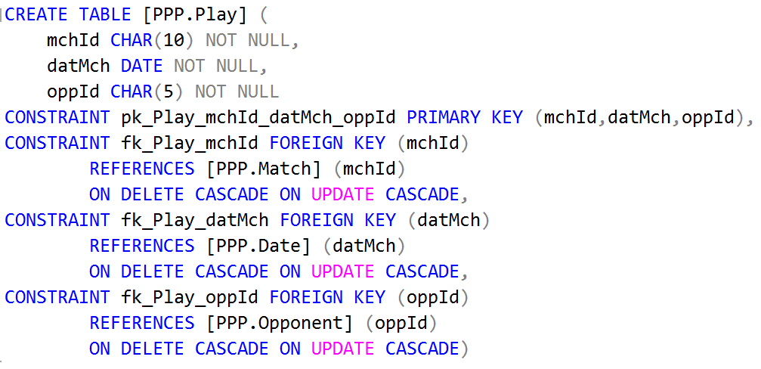
SQL CREATE TABLE: PLAY

Slide 19
04
USE
CASES

Slide 20
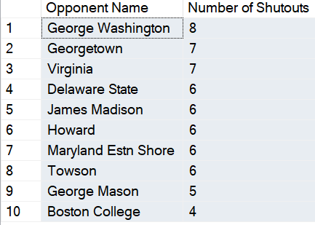
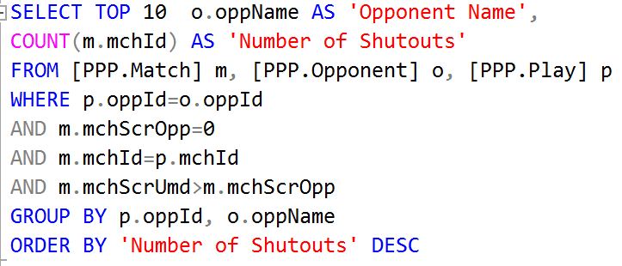
BUSINESS TRANSACTION 1
What are the details of the top 10 teams which Maryland has won against keeping a Shutout?

Slide 21
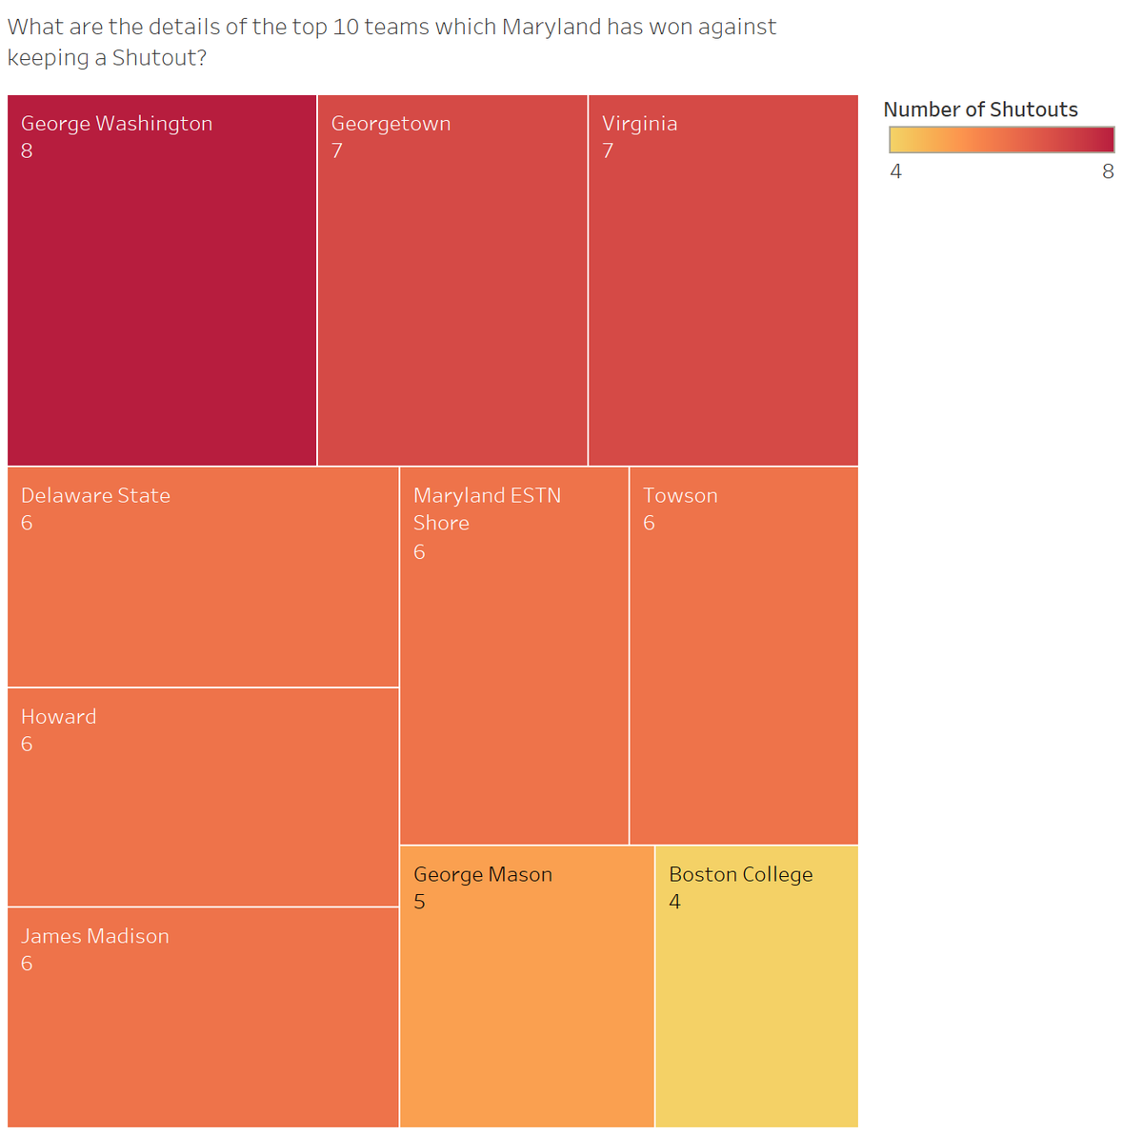

Slide 22
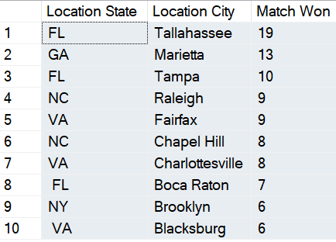
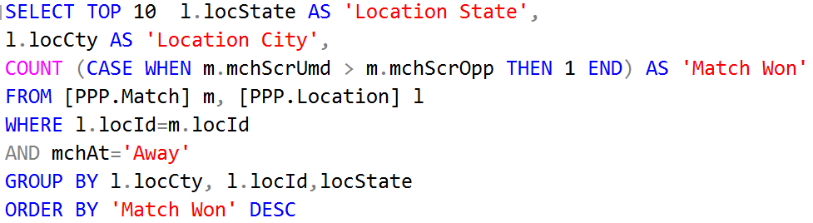
BUSINESS TRANSACTION 2
What are the details of the top 10 away locations where Maryland has won the most number of times?

Slide 23
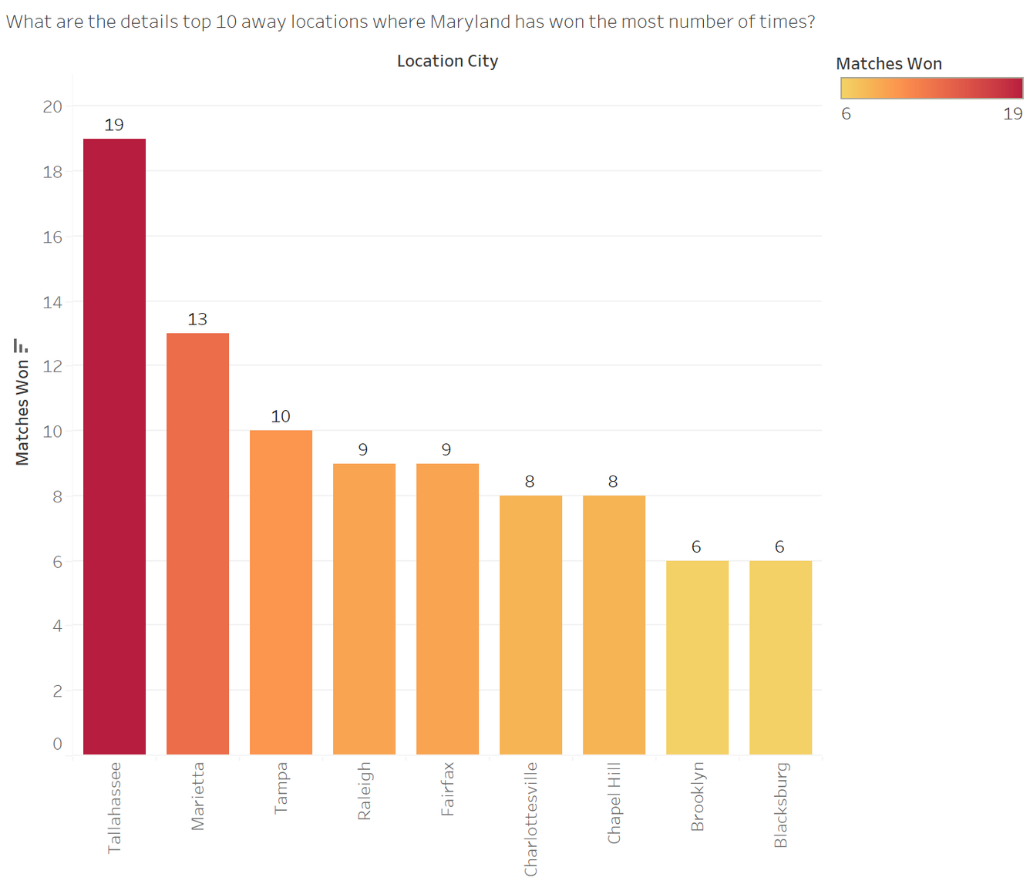

Slide 24
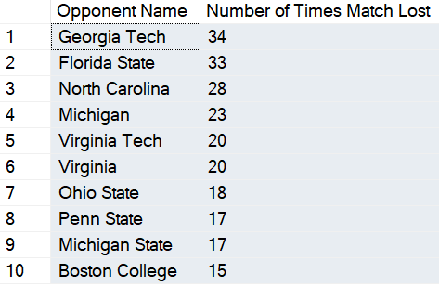
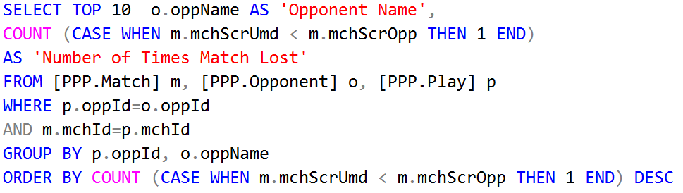
BUSINESS TRANSACTION 3
What are the details of the top 10 teams that Maryland has lost against the maximum number of times?

Slide 25
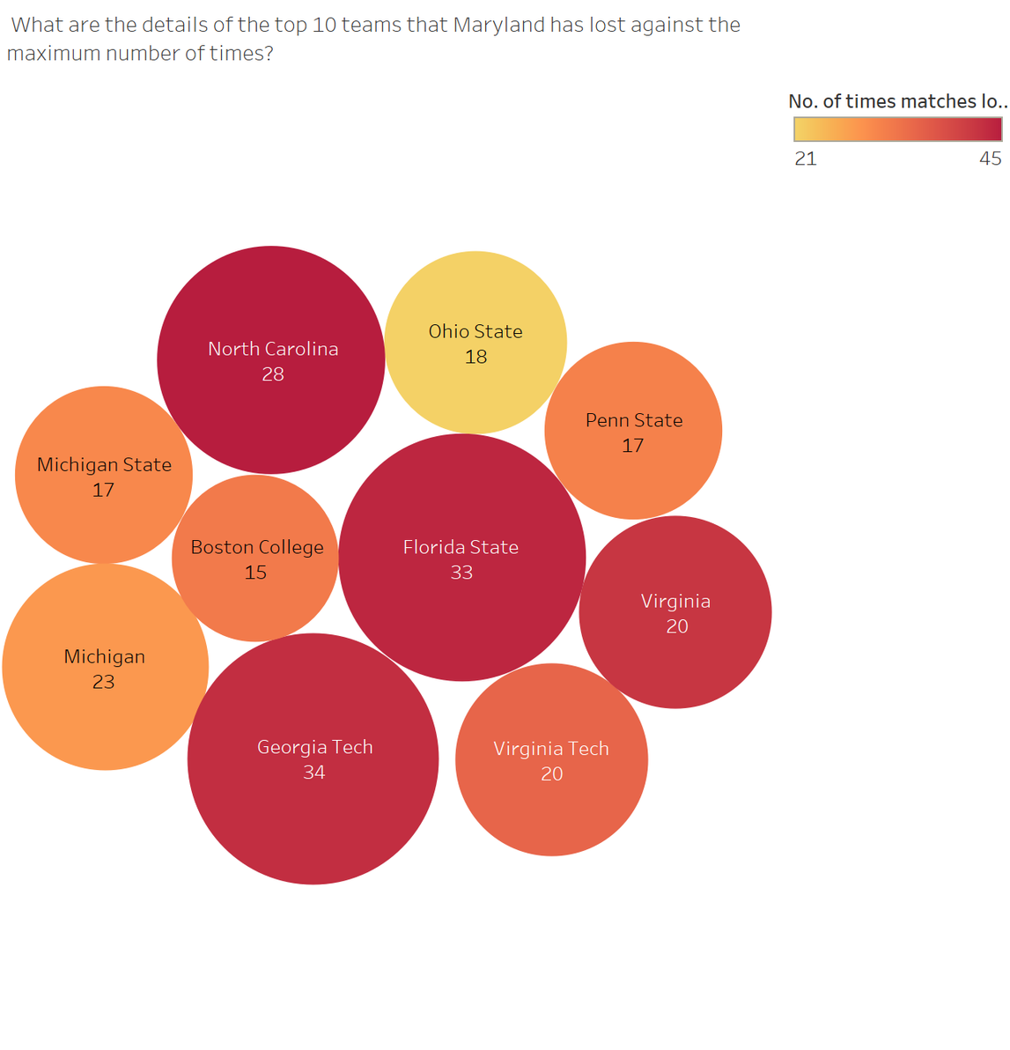

Slide 26
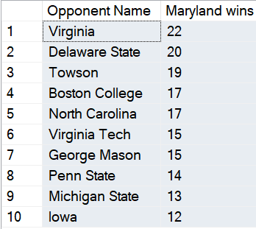
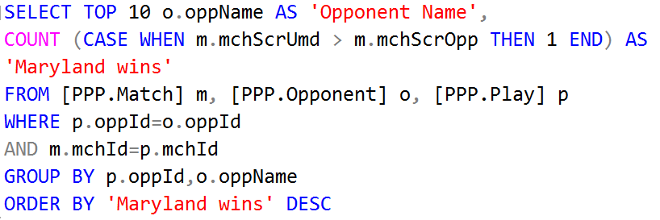
BUSINESS TRANSACTION 4
What are the details of the top 10 teams against which Maryland has won the maximum number of times?

Slide 27
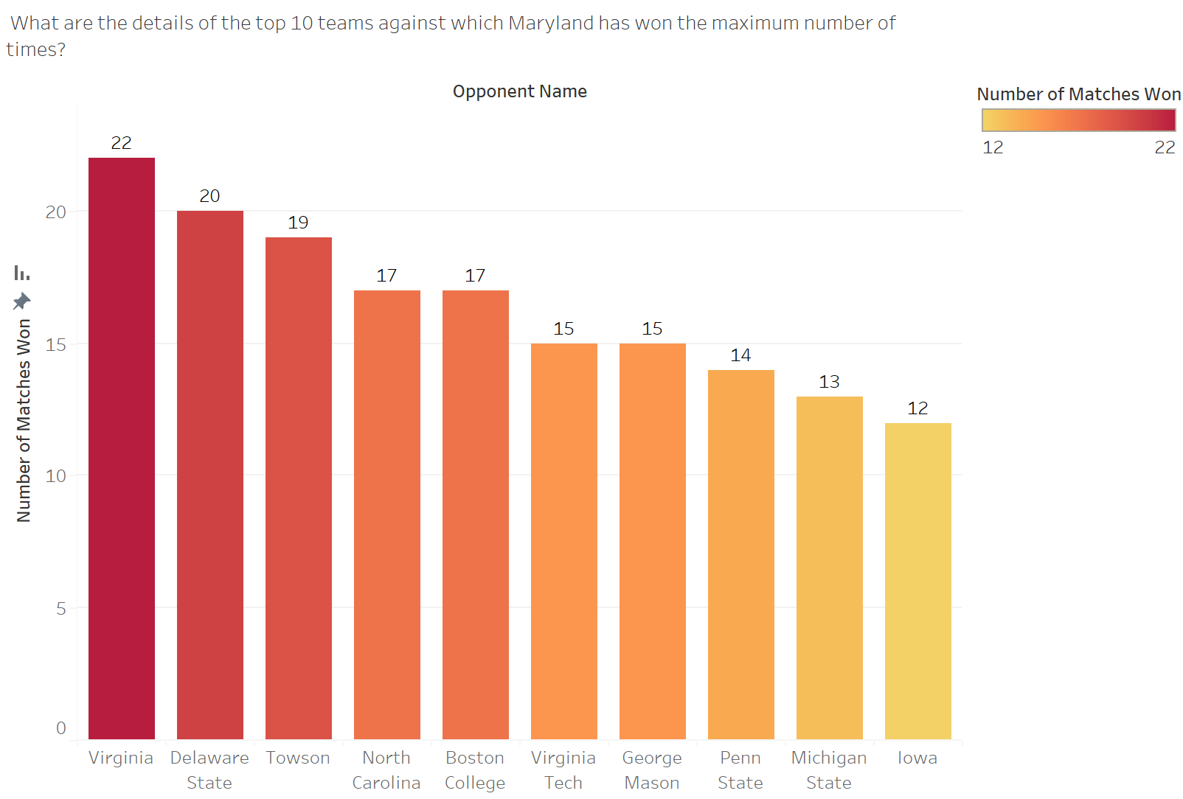

Slide 28
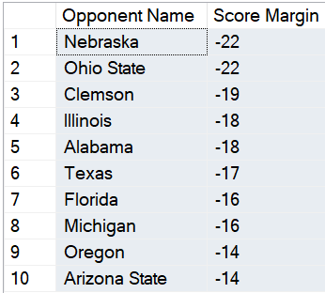
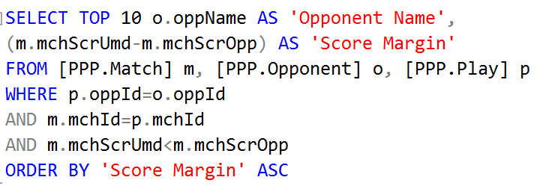
BUSINESS TRANSACTION 5
What are the details of the teams against which Maryland has Lost by the highest margin?

Slide 29
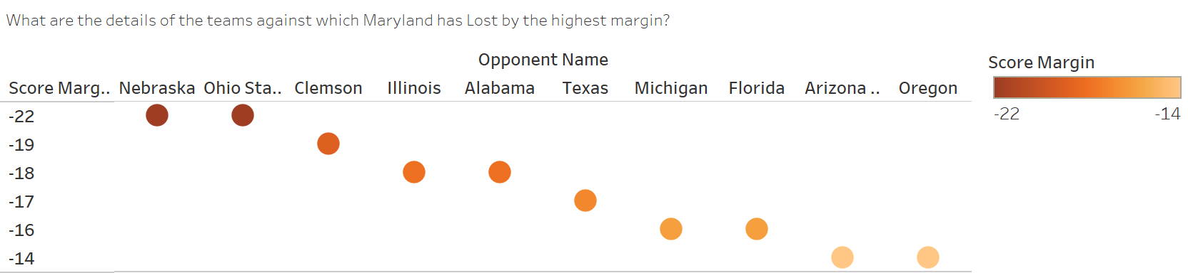

Slide 30
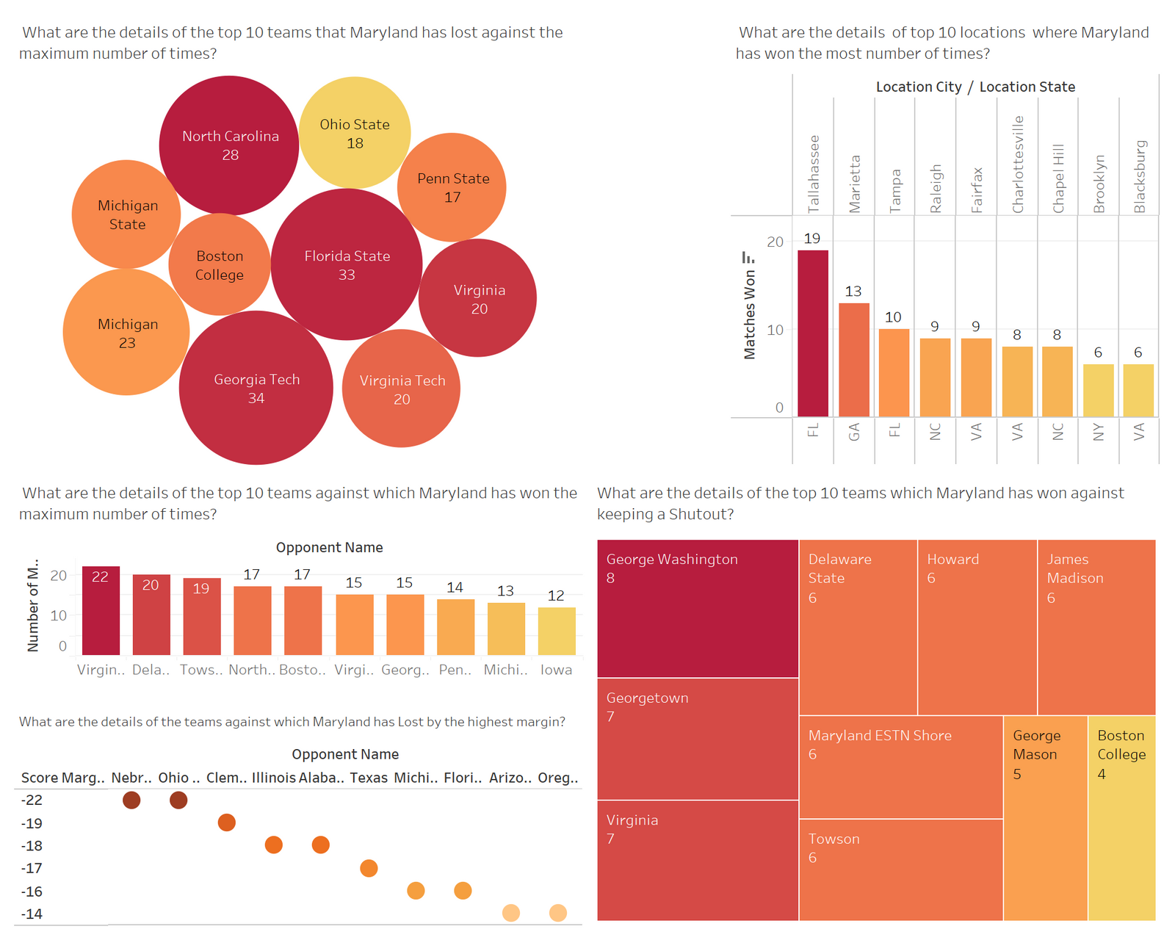
Dashboard

Slide 31
INSIGHTS
Number of “Shutouts” indicate impressive defensive play from the team, as it reflects a strong performance in preventing the opposing team's hitters from reaching home plate. It signifies effective pitching, solid fielding, and teamwork to keep the opponent from scoring. Maryland’s team showed impressive defensive play against George Washington 8 times, Georgetown 7 times etc.
In contrast, Maryland’s defeat with the highest margins against teams like Nebraska, Ohio State, Clemson etc. show where their pitching, fielding and overall defense was weak. They should focus on defensive aspects of their game against these opponents.
Maryland has dominated the most against teams like Virginia, Delaware State, Towson etc. They should be confident when playing against these teams.
The maximum number of defeats against teams like Georgia Tech, Florida State, North Carolina etc. shed light on against whom Maryland should practice more, get more fan support and improve their overall performance.

Slide 32


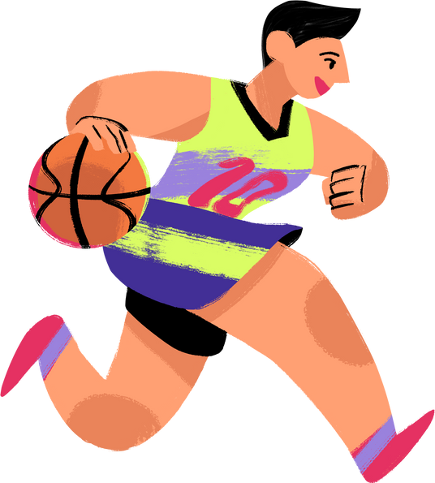
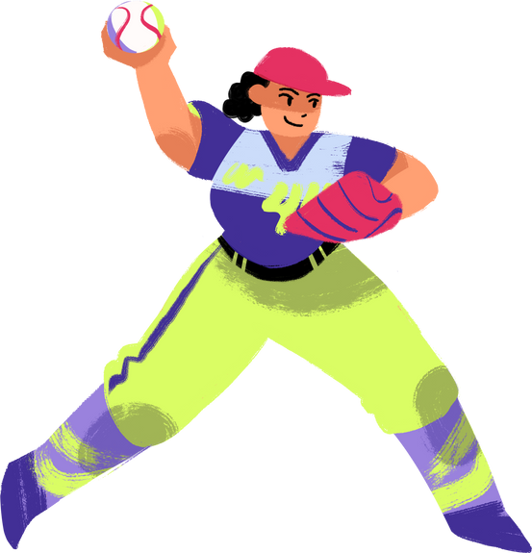
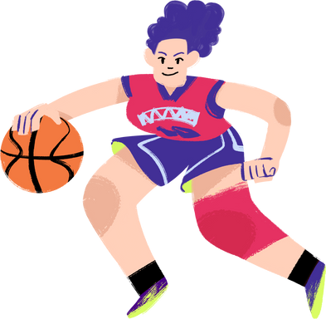






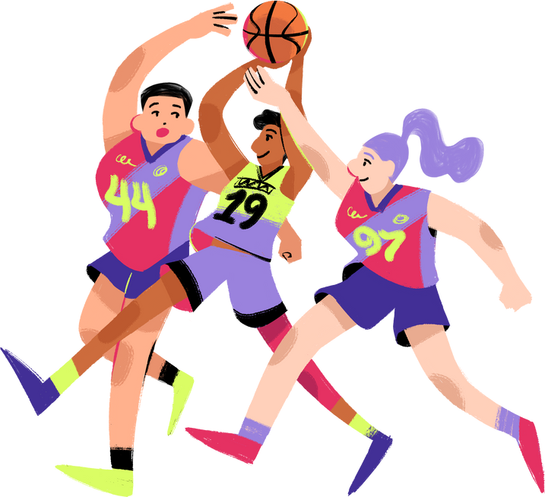

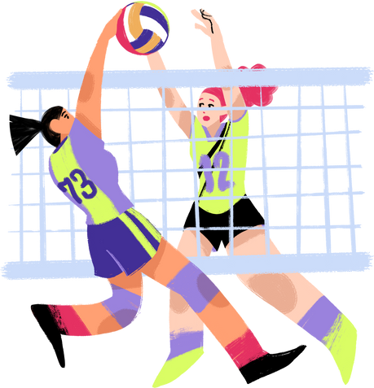
THANK YOU

Slide 33
QUESTIONS?

